Slide 1
Malignant or Benign?
Use Machine Learning to answer

Slide 2
Introduction
Project Name: Breast Cancer – Malignant or Benign
Student Name: Zheming Xu
Student Number: 501145468
Supervisor’s Name: Tamer Abdou
Purpose: Predict a patient’s breast cancer maglinant or benign

Slide 3
Techniques Implementation
Technique: Machine Learning
Technique Tool: Python with Pandas, Matplotplib, Seaborn, Sklearn and Numpy packages
Github link: https://github.com/checkming00/Ryerson_Final_Project

Slide 4
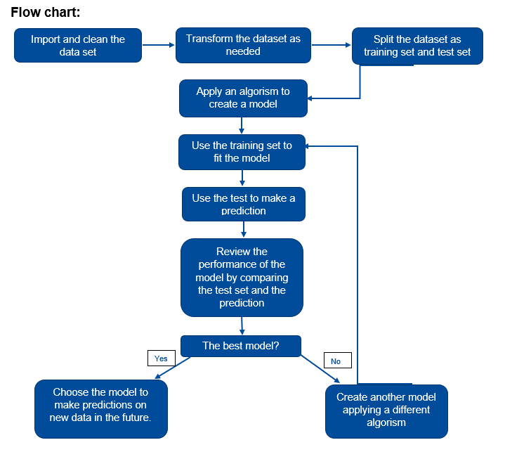
Process

Slide 5
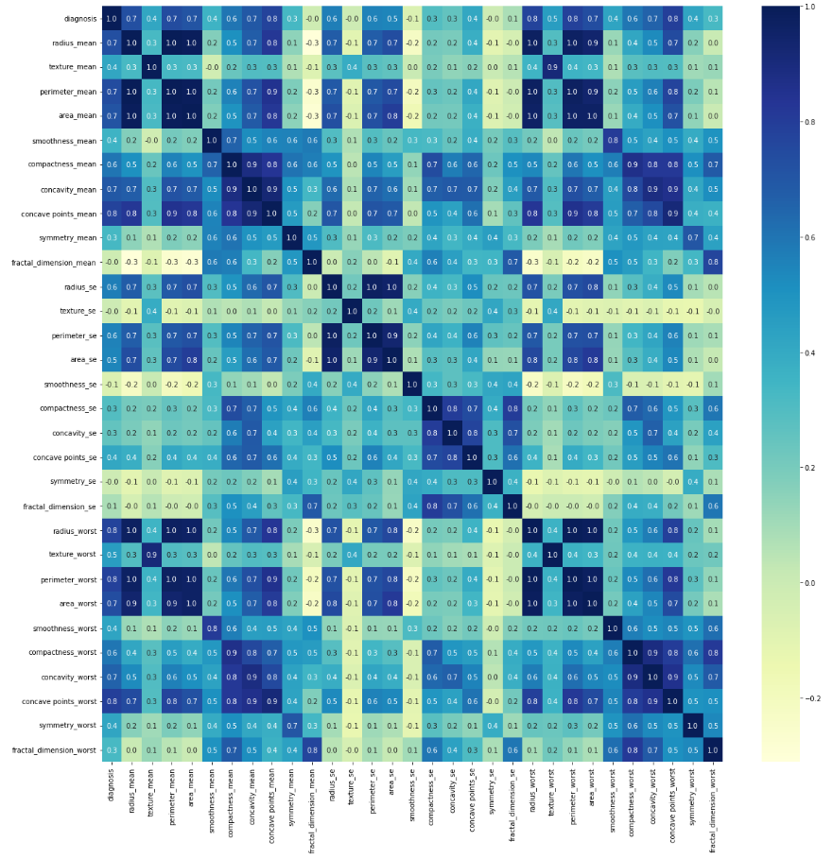
Exploratory Data Analysis (EDA)
Dataset shape 569 X 32
Count the unique value of the class B:M = (357: 212 / 63%: 37%)
Distribution of attributes. Only 4 of them are closed to normal.
Correlation heatmap

Slide 6
Exploratory Data Analysis (EDA)

Slide 7
Data cleaning & preparation
Convert data file format “CSV” to dataframe type
Drop “id” column
Convert the data type of “diagnosis” column to numeric. M->1, B->0

Slide 8
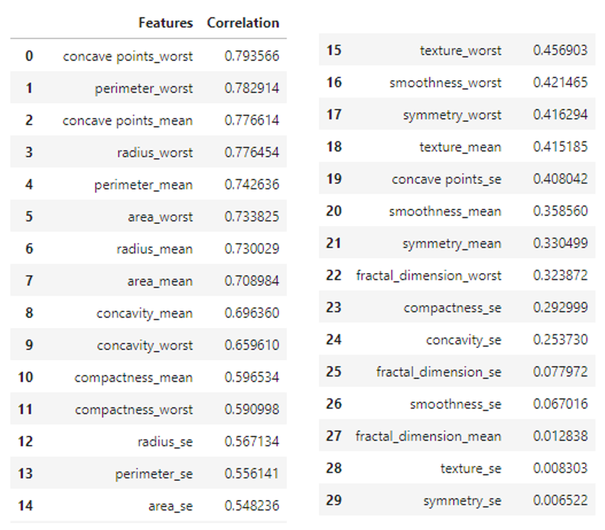
Feature selection
Correlation
Pearson Correlation between the class and features

Slide 9
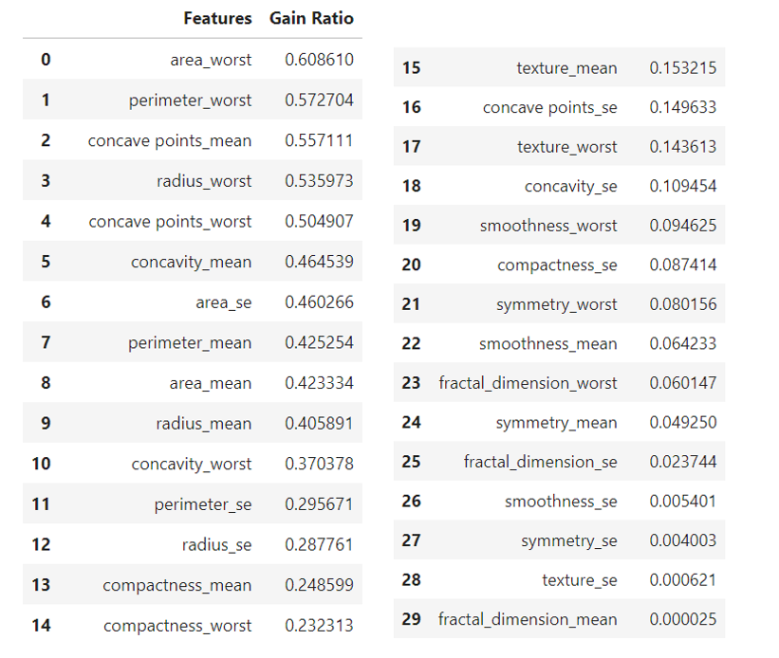
Feature selection
Gain Ratio
Information gain measures the reduction in entropy or surprise by splitting a dataset according to a given value of a random variable.
Gain Ratio is modification of information gain that reduces its bias.

Slide 10
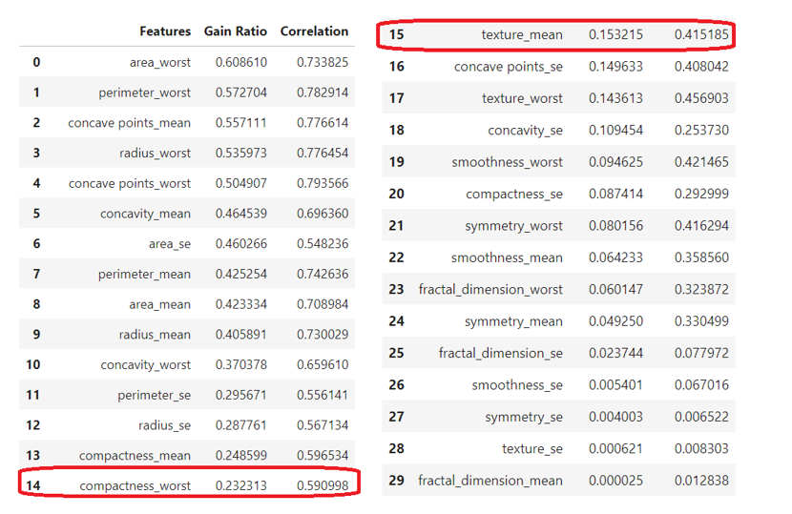
Feature selection
Combination
Merge the 2 lists to help decide appropriate features
As the list shows, correlation is under 0.5 while Gain Ratio is less than 0.2 (begins from feature “texture_mean”).
Correlation is weakness when it is under 0.5 and 20% of a Gain Ratio means it can get sufficient information after split.
Thus, I chose 0.2 Gain Ratio as the threshold to select features. That being said, the features with Gain Ratio greater than 0.2 were selected, totally 15 features in this case.

Slide 11
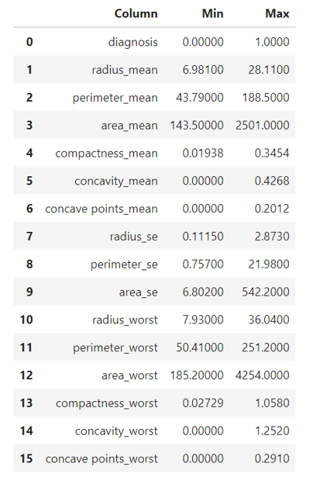
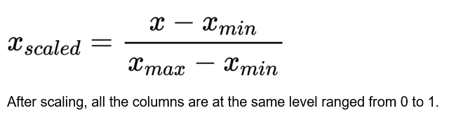
Scale data
The min-max list shows that the features and the class are not at the same level. It is necessary to scale the dataset.

Slide 12
Building models
Split the dataset
Split the dataset into training set and test set
In this study, the dataset has 569 records. A regular test set portion as 20%-40% can be considered. Thus, I used 70%-30%, 60%-40%, 80%-20% to split the data respectively and compare their performances.

Slide 13
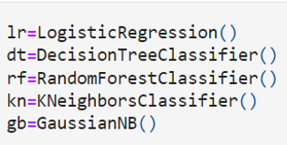
Building models
Build models
Use 5 algorisms to build models:
1. Logistic Regression
2. Decision Tree Classifier
3. Random Forest Classifier
4. K-Nearest Neighbors (KNN)
5. Gaussian Naïve Bayes

Slide 14
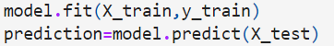
Evaluate models
Fit models and make predictions
Fit models with training set
Make predictions with test set features

Slide 15
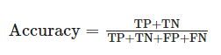
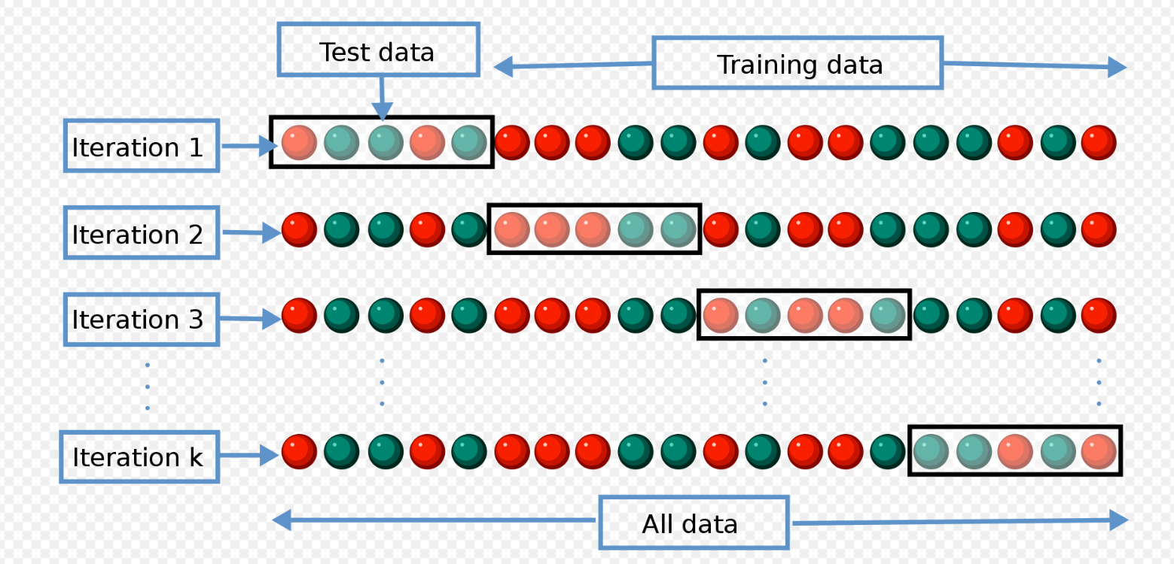
Evaluate models
Evaluation
Accuracy
Accuracy is the ratio of correct predictions.
2. Cross Validation
Cross-validation is a resampling method that uses different portions of the data to test and train a model on different iterations. It is mainly used in settings where the goal is prediction, and one wants to estimate how accurately a predictive model will perform in practice.

Slide 16
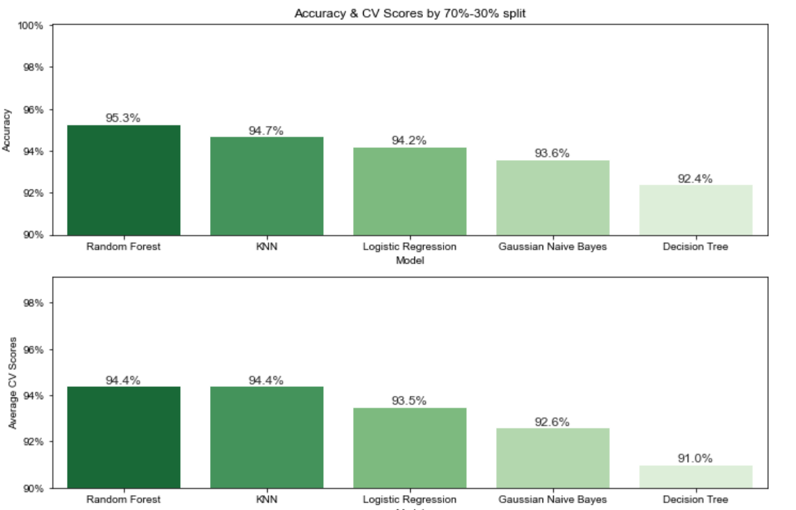
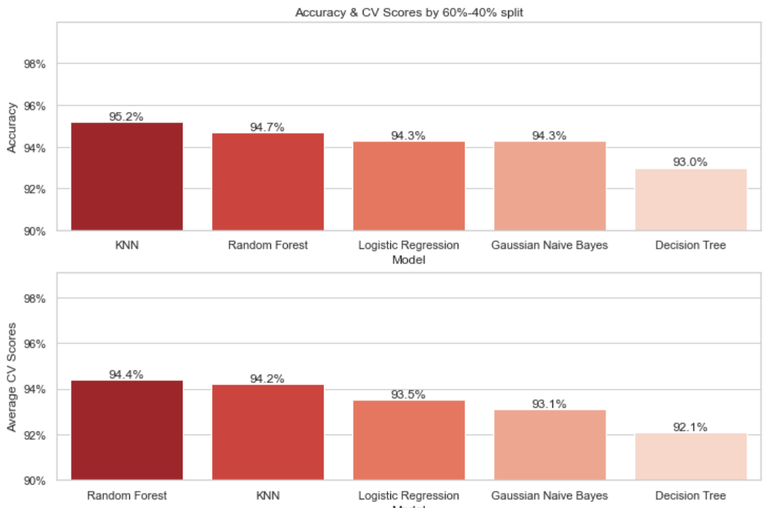
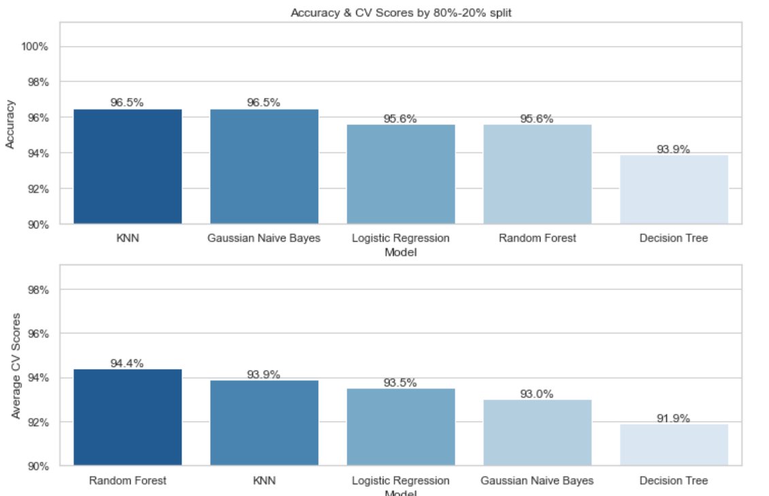
Compare models

Slide 17
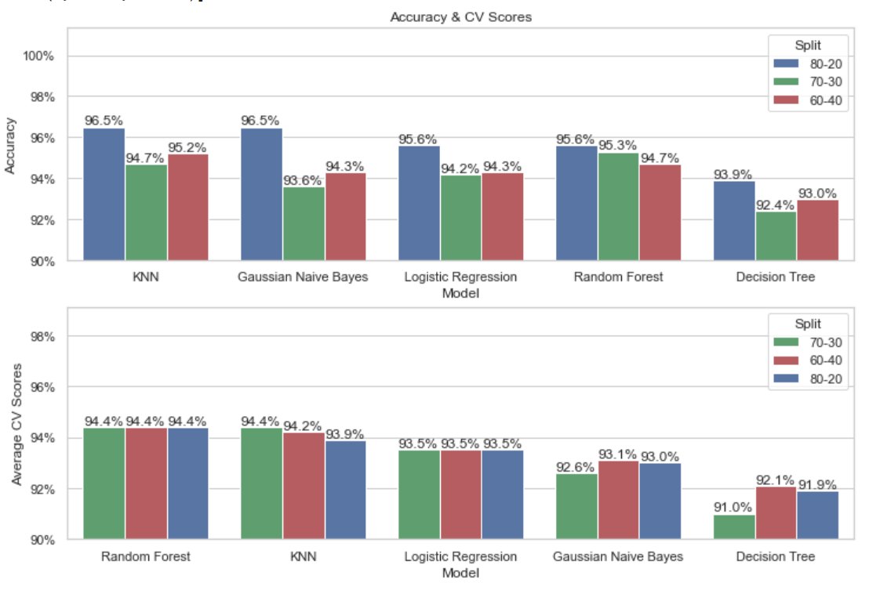
Compare models

Slide 18
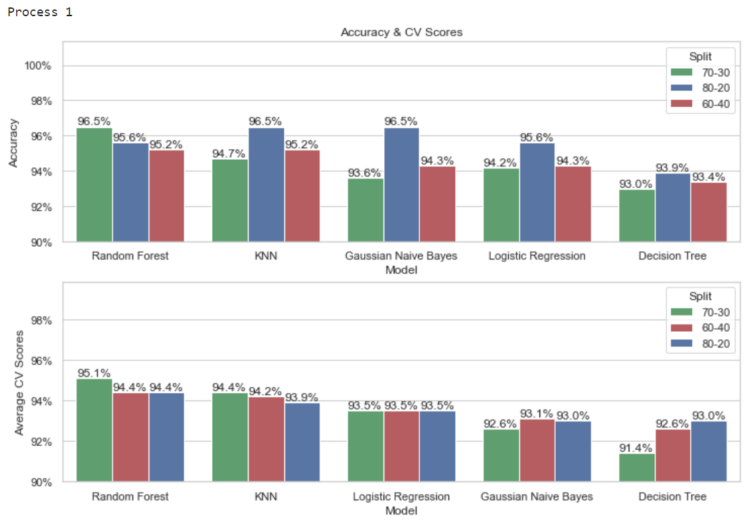
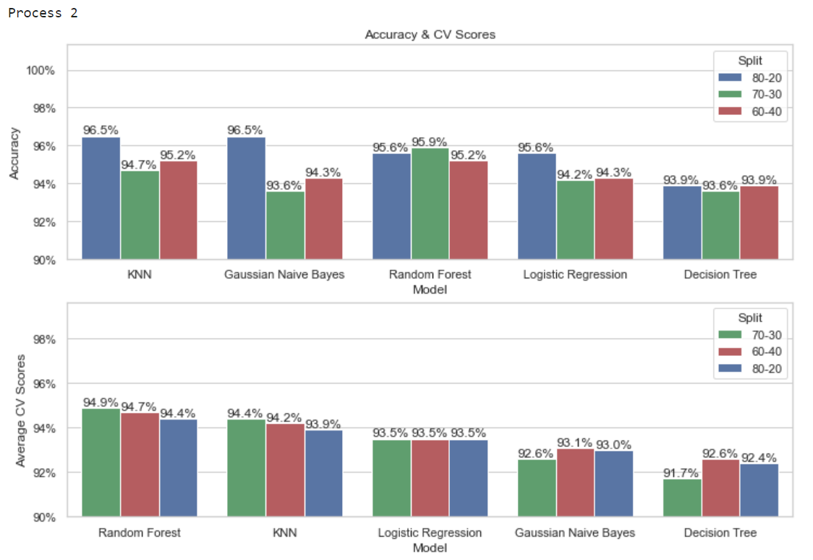
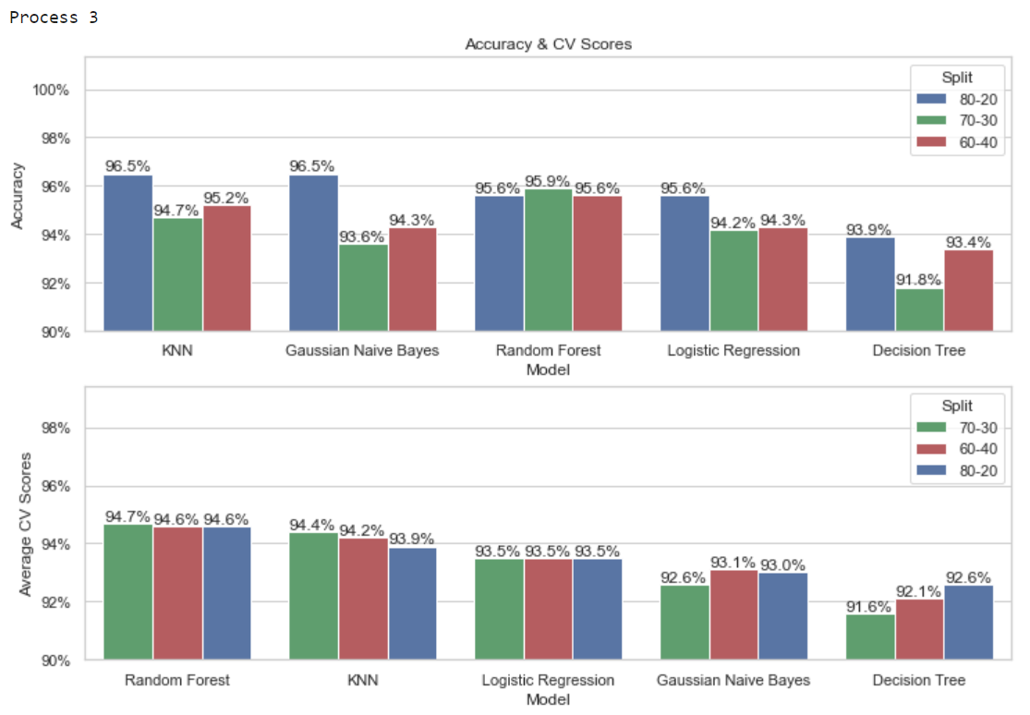
Compare models
Repeat the process from split the dataset to evaluation for 5 times.

Slide 19
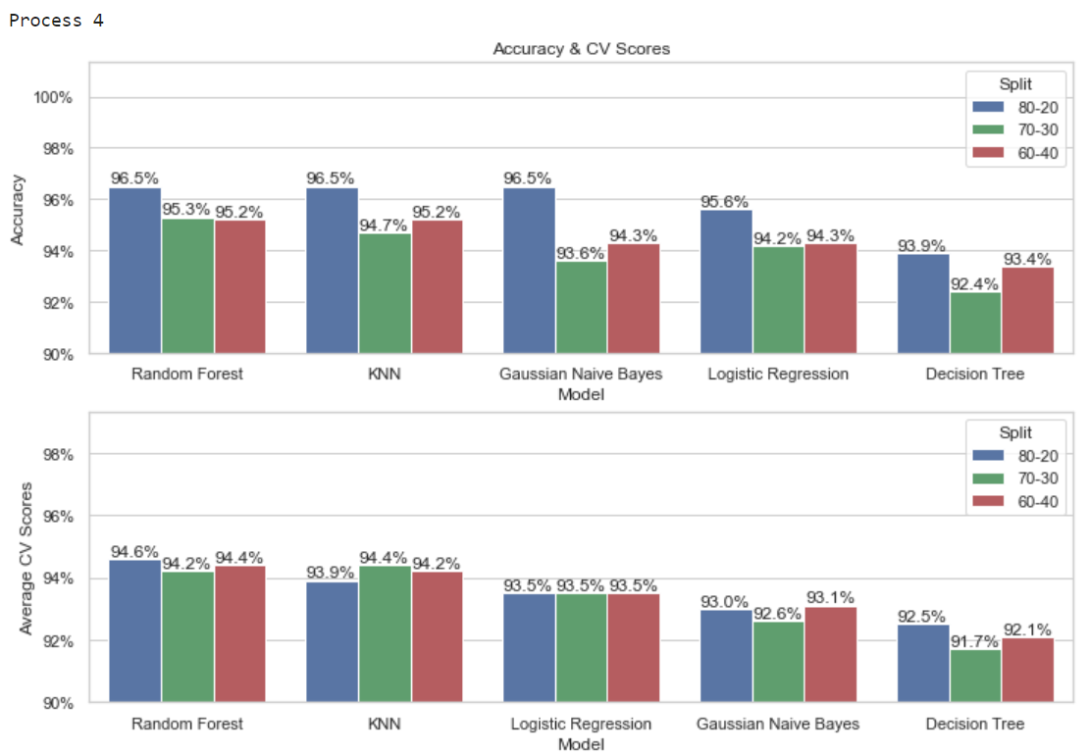
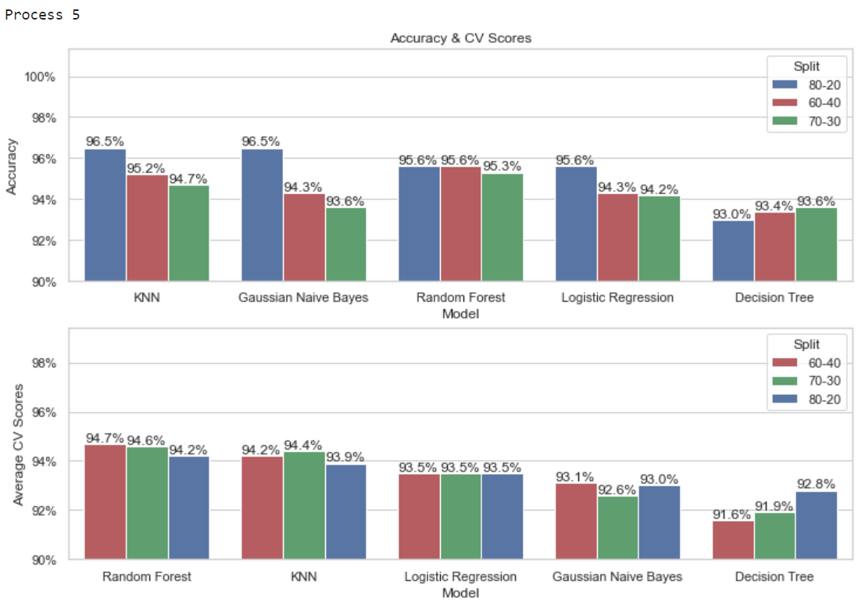
Compare models
Repeat the process from split the dataset to evaluation for 5 times.

Slide 20
Model selection
By the comparison, no matter the ratio of split, KNN model has the highest accuracy for 3 times and Random Forest has it for 2 times. While Random Forest has the highest cross validation score for all the times
Cross validation score is the average accuracy of all the folders. It trains models with all the data compared to a single accuracy which trains only a part of data. Therefore, in this case, cross validation score is more fair and more accurate.
Above all, the conclusion can be made:
The Random Forest model (100 trees by default) is the best choice to predict a patient malignant or benign.

Slide 21
Reference Ahmet Saygılıa (2018). Classification and Diagnostic Prediction of Breast Cancers via Different Classifiers. ISVOS Journal 2018, 2(2):48-56 Wisconsin Diagnostic Breast Cancer (WDBC) Data Set. (n.d.). Retrieved February 07, 2023, from https://archive.ics.uci.edu/ml/datasets/Breast+Cancer+Wisconsin+(Diagnostic) Street, W. N., Wolberg, W. H., & Mangasarian, O. L. (1993). Nuclear feature extraction for breast tumor diagnosis. IS&T/SPIE's Symposium on Electronic Imaging: Science and Technology, 1915, 861-870. Guyon, I., Weston, J., Barnhill, S., & Vapnik, V. (2002). Gene selection for cancer classification using support vector machines. Machine Learning, 46(1-3), 389-422. Rokach, L., & Maimon, O. (2010). Data mining with decision trees: theory and applications. World Scientific. Sung, H., Kim, J., Lee, H., & Kim, Y. (2015). Prediction of breast cancer subtype based on gene expression data using random forests. Journal of medical systems, 39(2), 313-319. Friedman, J., Hastie, T., & Tibshirani, R. (2001). The elements of statistical learning: Data mining, inference, and prediction. Springer Science & Business Media.

Slide 22
The End

Slide 23
Thank you for your time!

